Slide 1


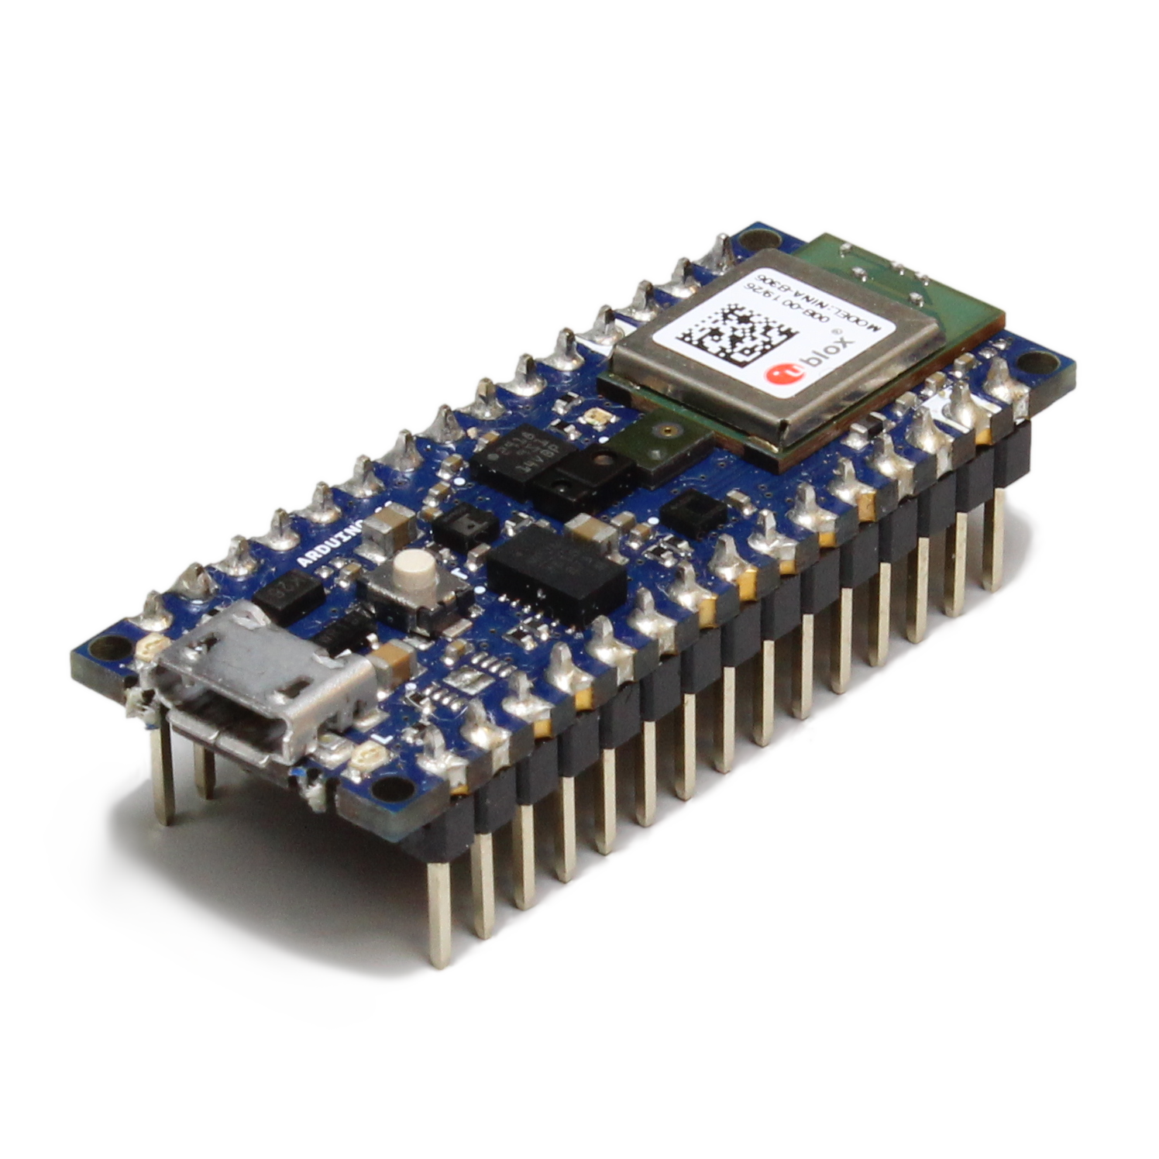
Train model
Collect data
Deploy model
Train model
Collect data
Deploy model

Slide 2
Train model
Collect data
Deploy model
☹️

Slide 3
Extract Features
Train model
Collect data
Deploy model

Slide 4
Train model
Collect data
Deploy model
Train model
Collect data
Deploy model

Slide 5
Train model
Collect data
Deploy model

Slide 6
Train model
Collect data
Deploy model

Slide 7
Holdout Method
Tweak hyperparameters
and repeat training until model performs well on
validation data
Dataset
Training Set
(60%)
Used to train model
(update parameters)
Model
Model
Used to validate model
on unseen data
Validation Set
(20%)
Randomly divide dataset
Final test to evaluate model performance
Test Set
(20%)

Slide 8
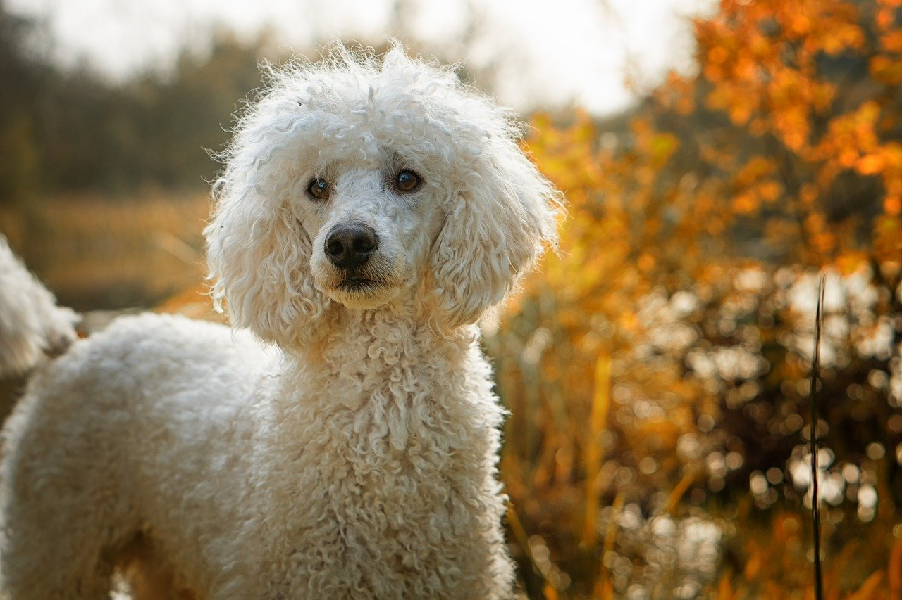
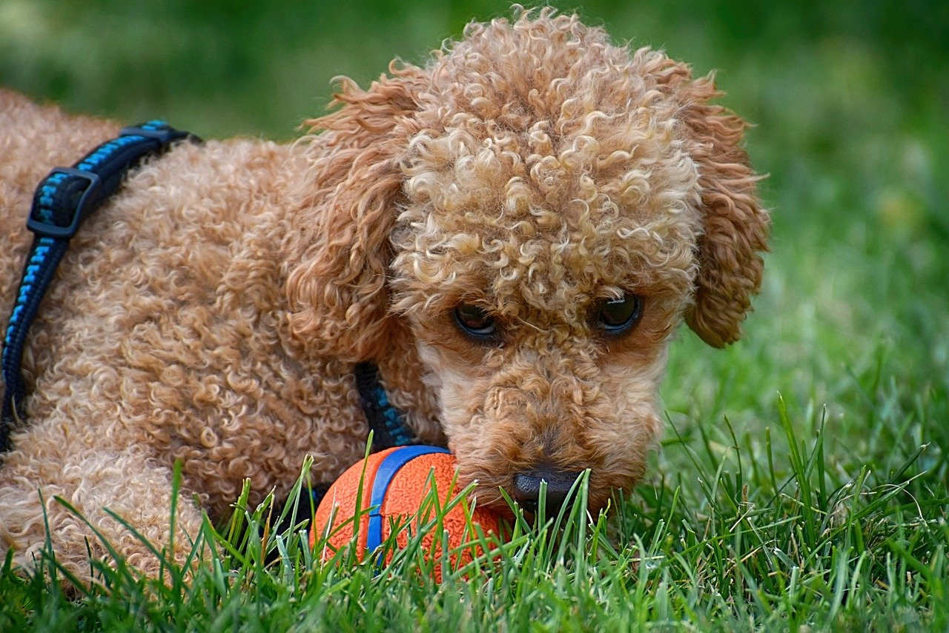
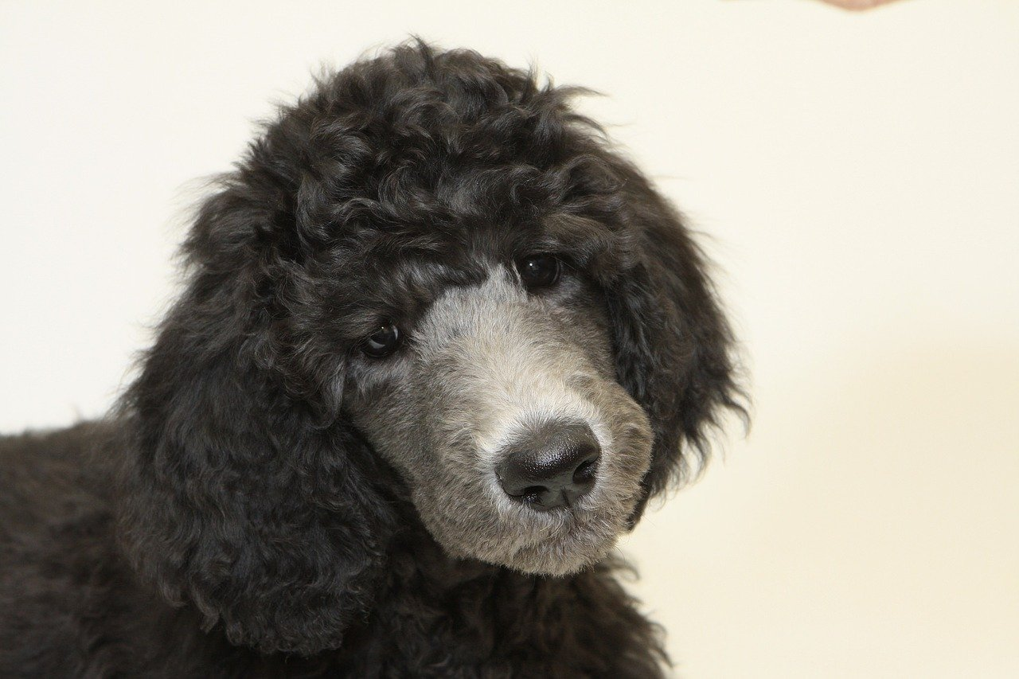
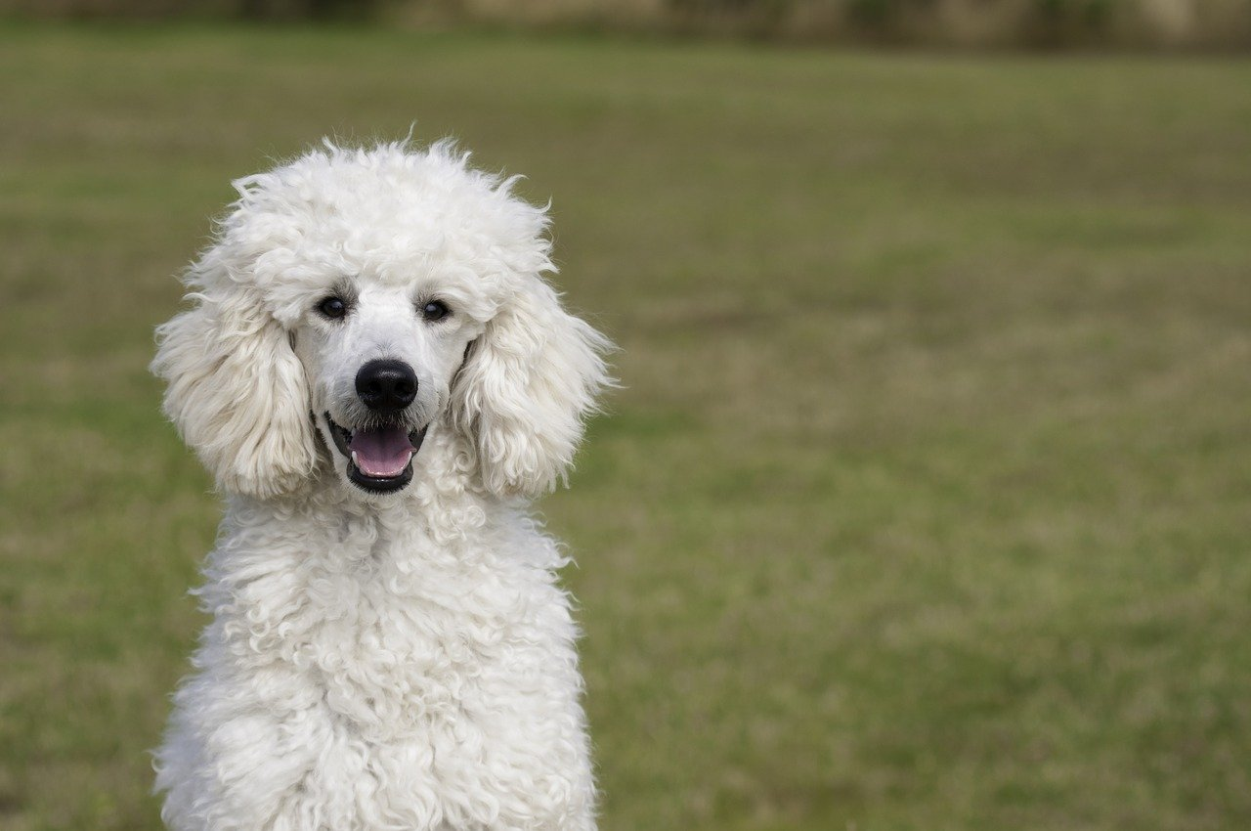

Think about your data!
Train
Model
Dog?
Test
Training Data
Test Data

Slide 9

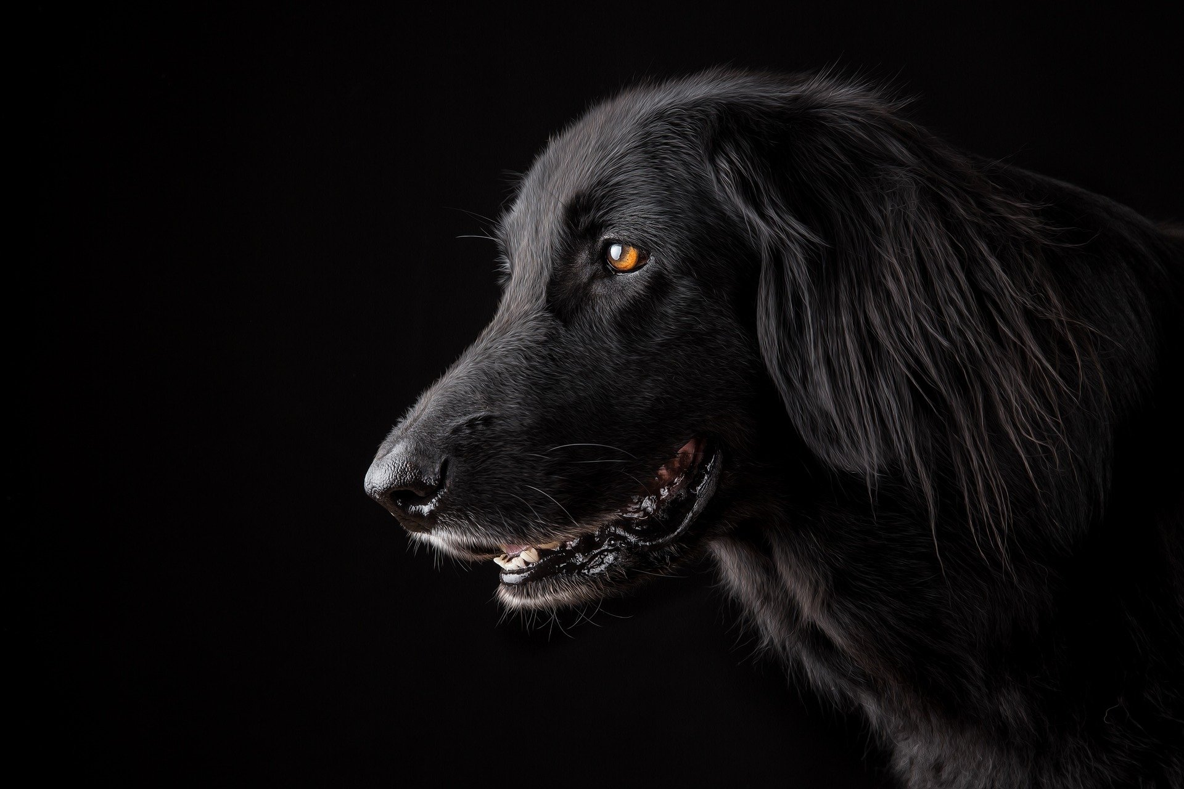
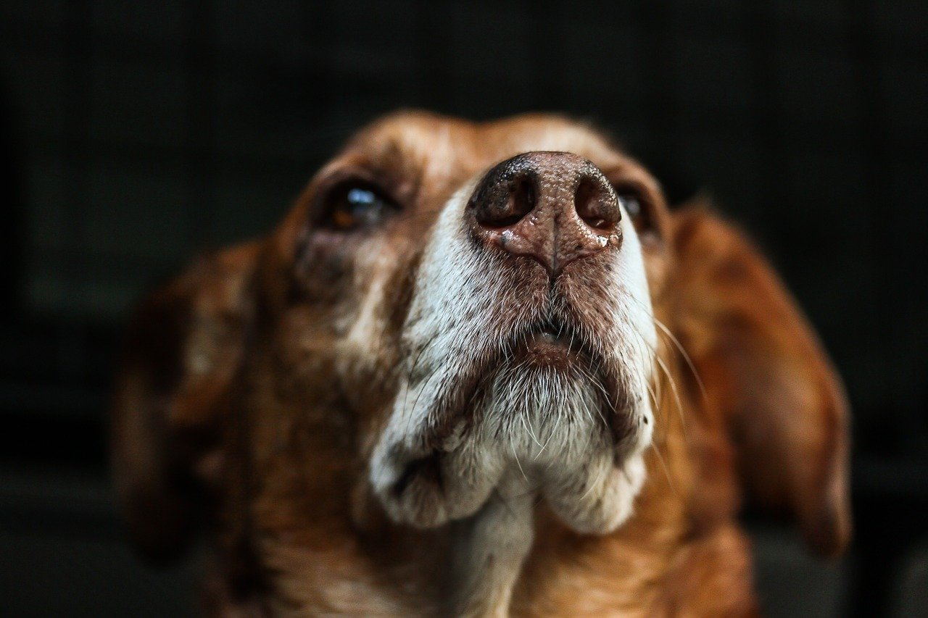







Slide 10
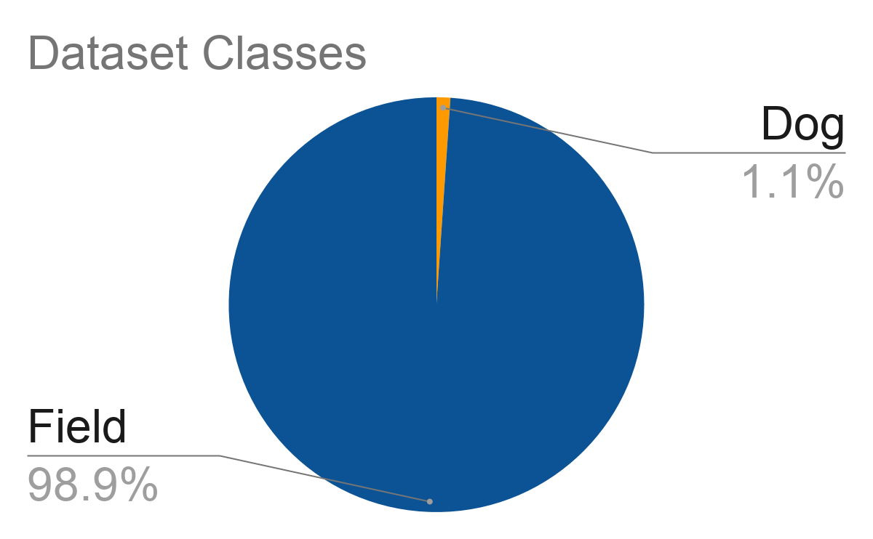
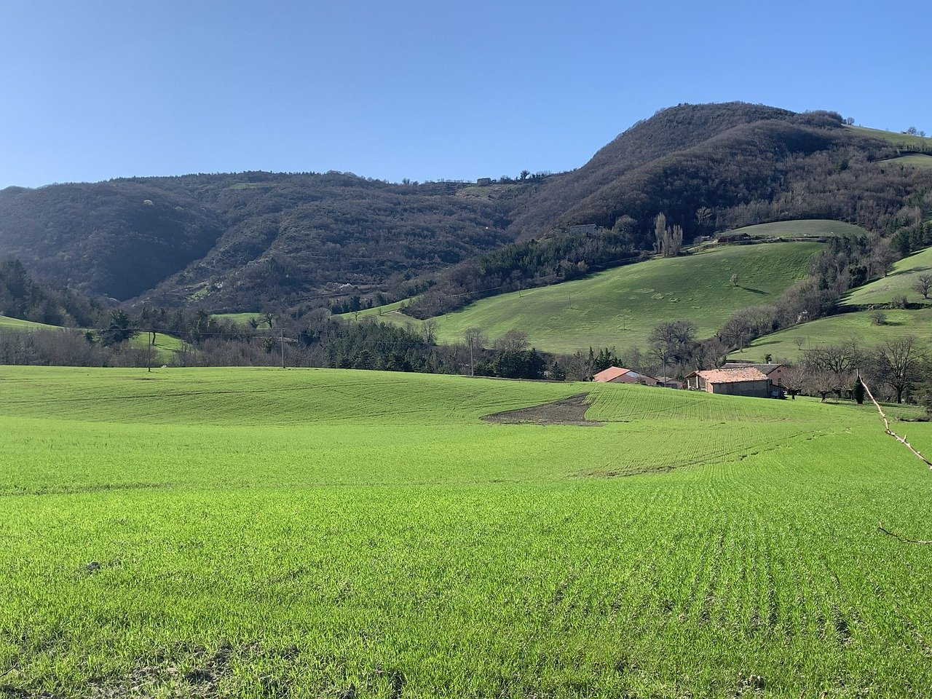
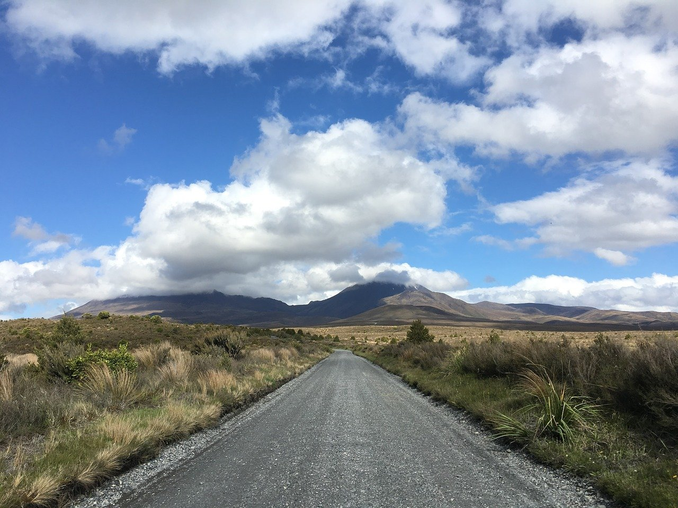
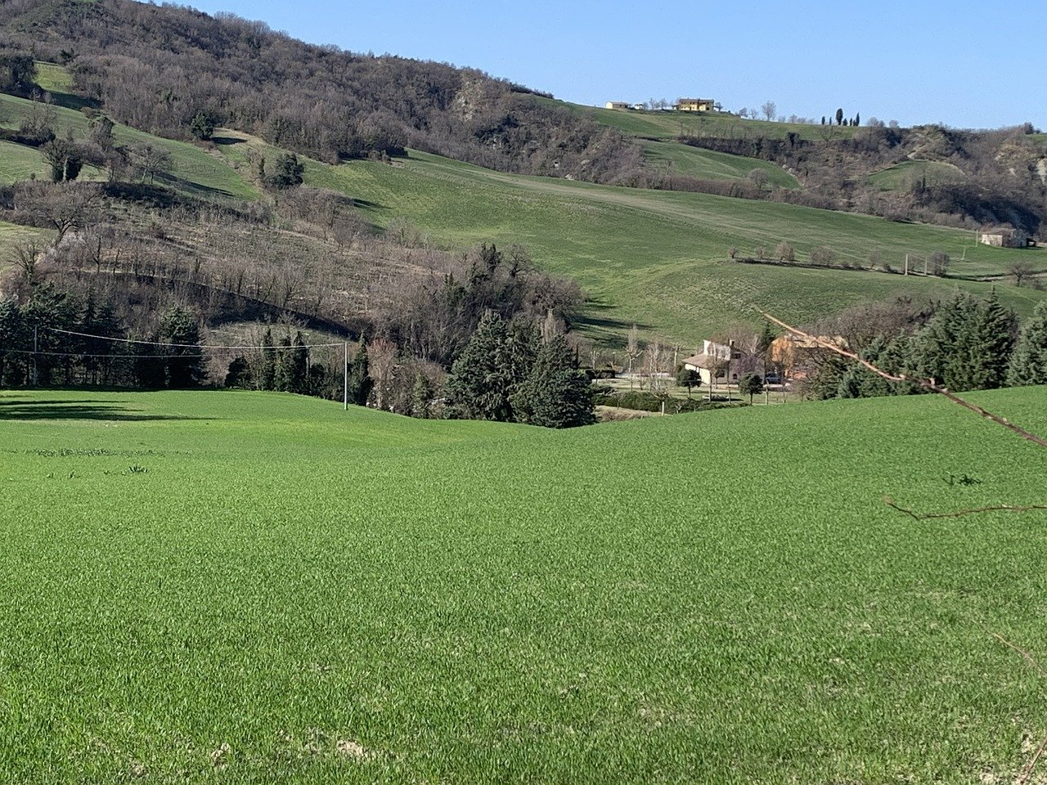
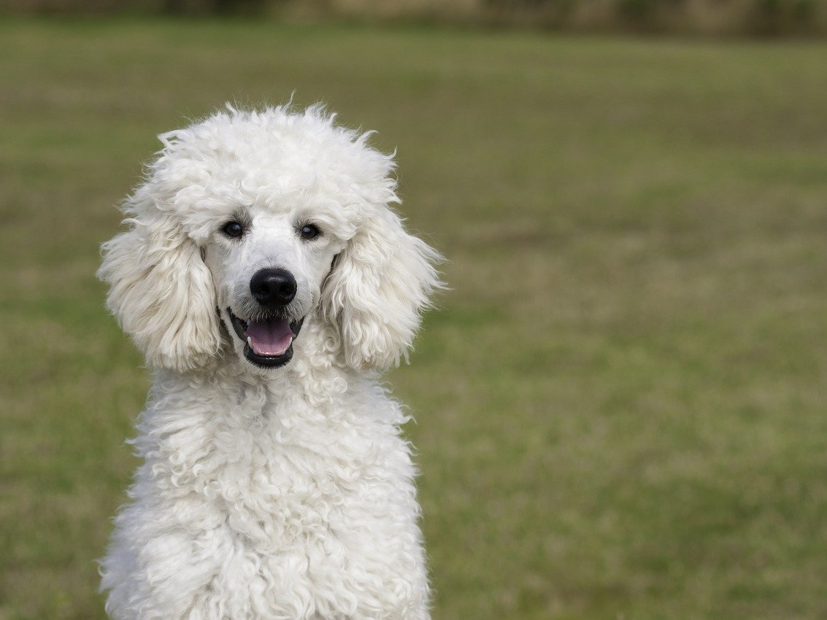

Balanced Dataset
Field
Field
Field
Dog
Field
Train
Model

Slide 11
Balanced Dataset
Model
Random image
Always field
99% accuracy!
“Naive classifier”

Slide 12
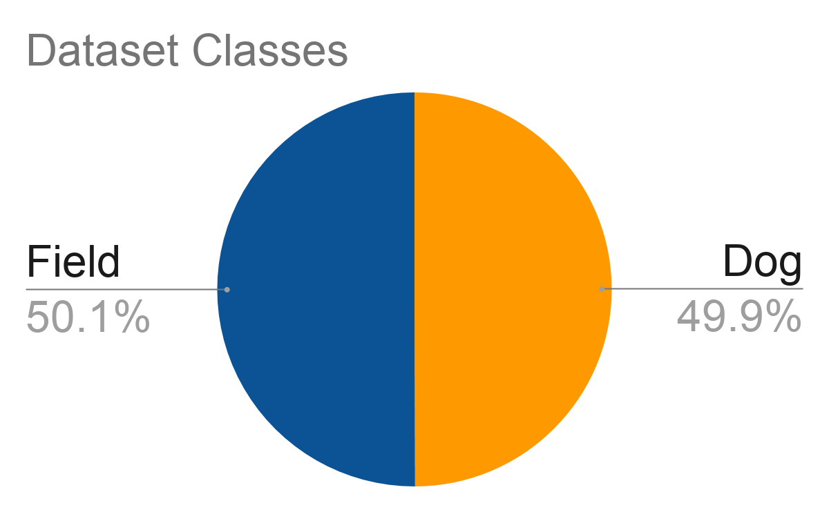
Balanced Dataset

Slide 13
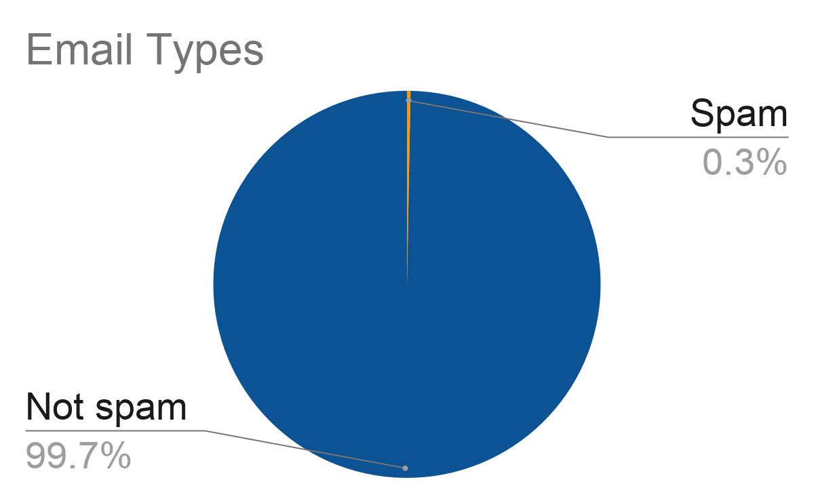
Anomaly Detection

